Slide 1
Best Travel Deals
Kanza Jamil, Maria Jayakumar, Miriam Santana, Jiu Wang

Slide 2

Look no further! We make travel hassle free and scan through all other sites to ensure you get the best bang for your buck! Our agents work tirelessly to get you exactly what you need.

Slide 3
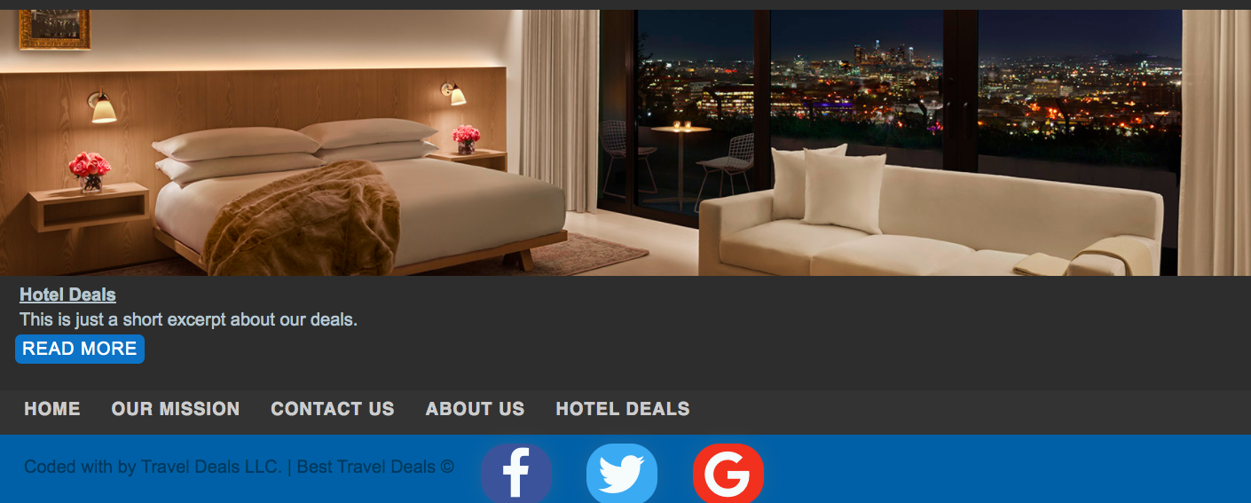
Concept
As a User I want to find the best deals and discounts on Hotels so I can have a more economic vacation.
I will be using booking.com to find hotel deals
I will compare hotel prices through other websites to ensure I receive the best deal

Slide 4
Process
Our website consist of HTML, CSS and JavaScript
Kanza started it off with the outline using HTML, Miriam then styled it using CSS and Susan added on to the CSS portion, Maria then got to work on the Javascript portion. We all ended up working on javascript and APIs to touch up on one another's work.
Our biggest challenge by far would have to be the API’s we struggled with finding the correct ones for the website and had to change up our website through the end of the process due to the API’s.
Our biggest success is we are able to come together as a team and be able to work through the challenges.

Slide 5
Demo

Slide 6
Directions for Future Development
Moving into future development we definitely want to plan better and especially when it comes to the API’s. Once we see what works and what doesn't we would move forward with what we want to do. Since we are a travel company one of our priorities is adding flights and transportation in the near future.

Slide 7
Links
https://github.com/santanam23/Best-Travel-Deals
https://santanam23.github.io/Best-Travel-Deals/

